Slide 1

MateriaL Handling Training

Slide 2
Scope
The process of how stock product is moved within the Distribution Center.

Slide 3
Basic Training needed for this process:
Appropriate Oper1 screens
How to use the RF scanner
Knowledge of Distribution Center Stocking Locations

Slide 4

1.Product Movement
1.1.Product is assigned to stocking locations within the warehouse.
1.2.Product is scanned from in-transit (OT OZ) or overstock locations (OS) to the following:
1.2.1. Primary Shelf Stocking Location (small racks).
1.2.2. Another overstock or in-transit location. (regular racks).

Slide 5
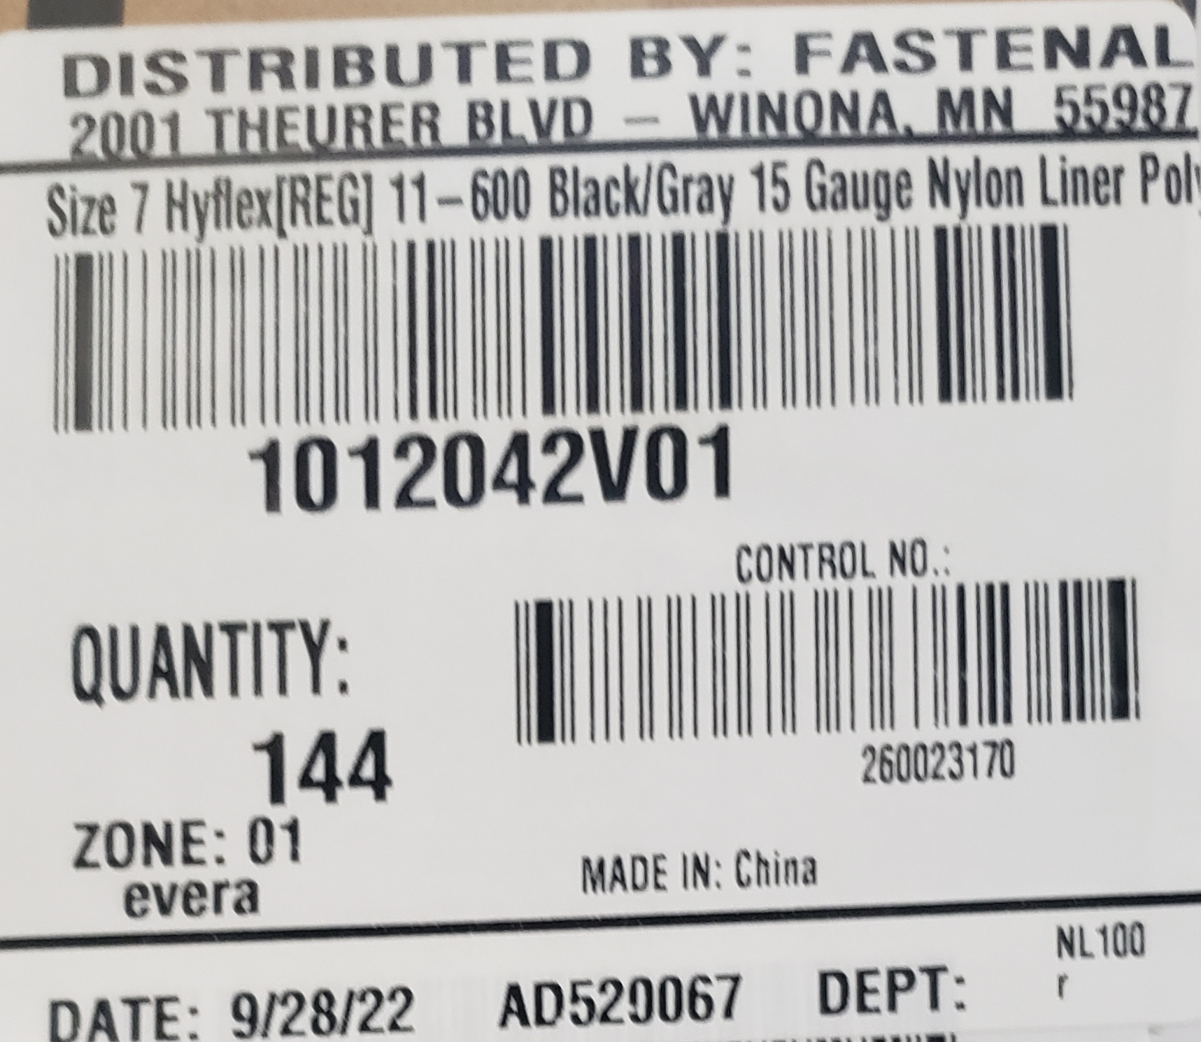
1.Product Movement
1.3.The primary location is identified by the product label or the location listed in the system.
1.3.1. Contact your Lead if there are items that do not have a primary location assigned.

Slide 6
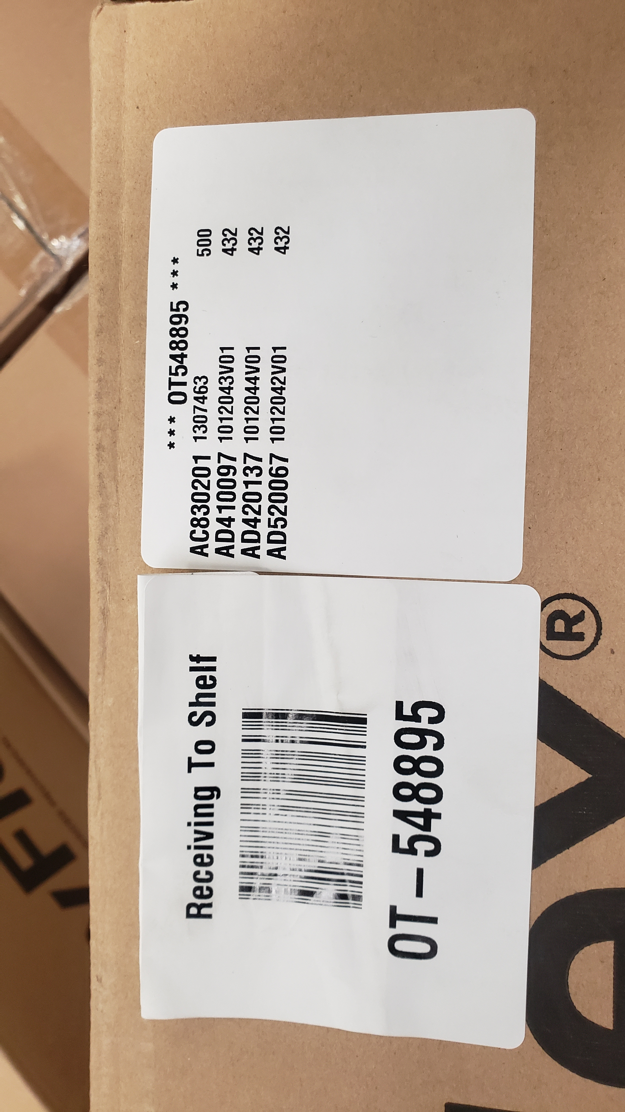
2.Product Movement
2. Any stock product moved using a forklift should be scanned to an in-transit location if the product will not be moved directly to a primary or overstock location.

Slide 7
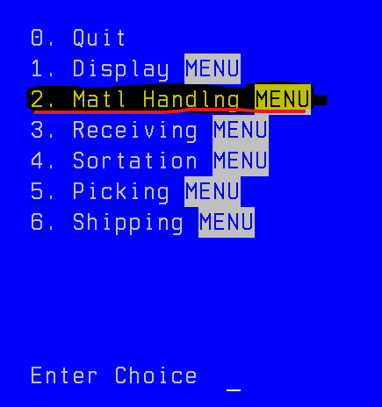
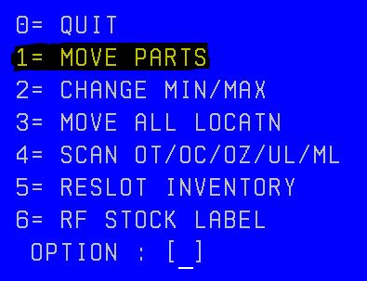
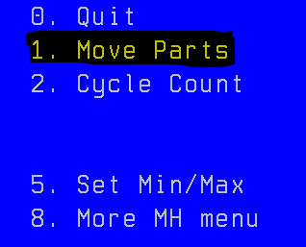
3.Oper1 operation
Moving one part number
1.- Main Menu.
Select option 2 (Matl Handlng).
2.-.Select option 1 (Move Parts).
3.- then again
Select option 1 (MOVE PARTS)

Slide 8
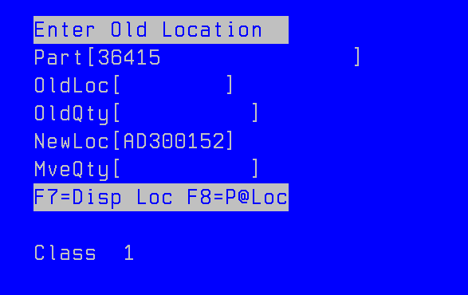
3.Oper1 operation
3.1. Move Part: product movement screen
Scan or enter the part number on the product.
Scan or enter the part number on the product.
Quantity in the previous location.
Scan or enter the new location that the part will be stored.
Amount of material to move.
F7: look where other locations have the same Part Number.
F8: look what other Part Numbers are in the location.

Slide 9
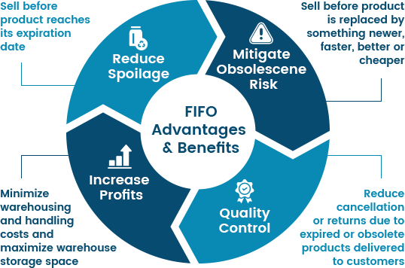
4. Location Maintenance
4.1. Rotate product whenever possible.

Slide 10

4. Location Maintenance
4.2. Items in a shelf or overstock location that are unlabeled or damaged must be removed & staged in a designated area for resolution (at the end of conveyor).

Slide 11
MH organigrama de actividades
MH
Operación
Administración
Restock
Shelf mant
Labor intensive
Empty locs
Subir
Espacios
Consolidar
Agin report

Slide 12
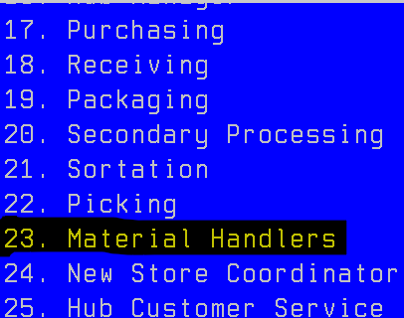
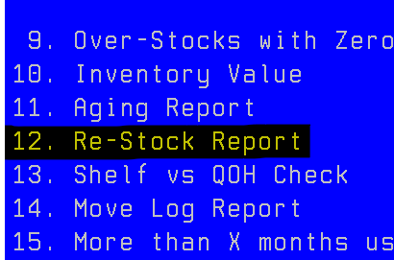
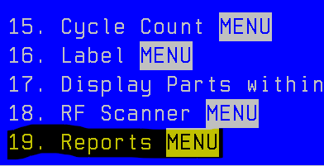
1 restock
Generating a new restock report.
1.- Open Oper1 in a Computer.
Select option 23 (Matl Handlers).
2.-.Select option 19 (Reports).
3.- Then
Select option 12 (Re-Stock Report)

Slide 13
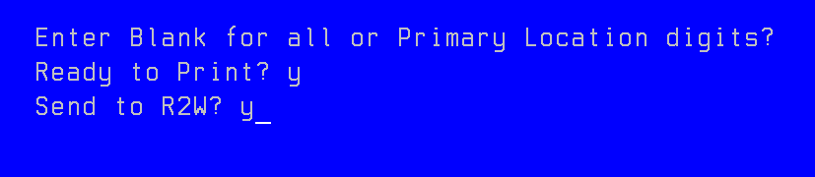
1 restock
Generating a new restock report. (main page option: 23-19-12)
Press enter
Type y and then enter
Type y and then enter
We need to search the generated file in FASTNET

Slide 14
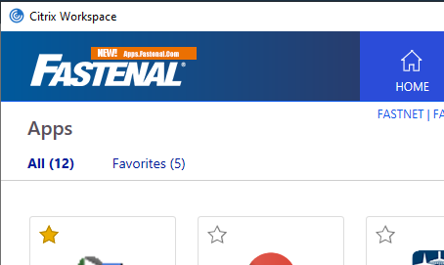
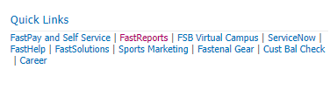
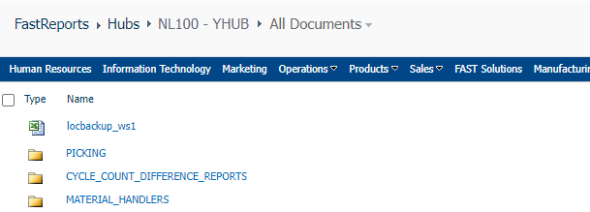
1 restock
Obtaining the generated restock report.
Obtain restock report
Pathway: go to FASNET
You can find a direct access in Citrix
On the main page of fastnet at the right side below you can find the quick links then select FastReports
Search for a MATERIAL_HANDLERS folder

Slide 15
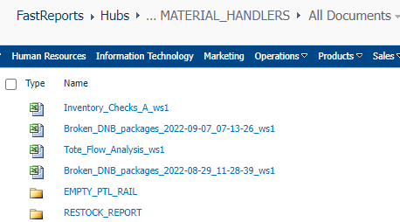
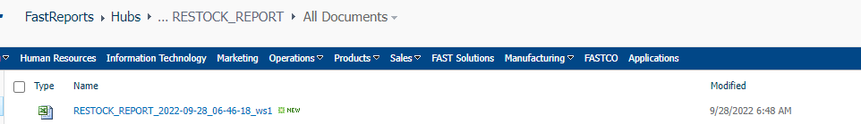
1 restock
Select RESTOCK REPORT folder
Check the date coincides with the day and open the file.

Slide 16

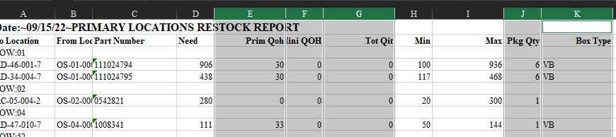
1 restock
Format Restock Report.
Once you open the excel file this box text appears ignore this and click yes
Delete columns E F G J and K

Slide 17
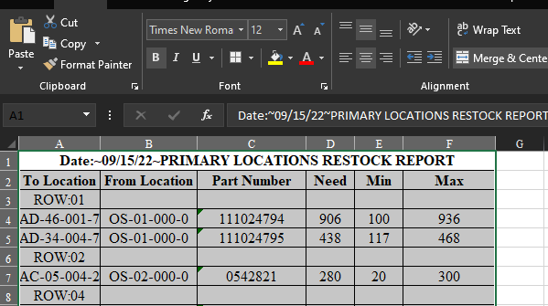
1 restock
Format Restock Report.
Format as you like in this example we:
Change font size
Put all borders
Select middle align and center
merge and center first row

Slide 18
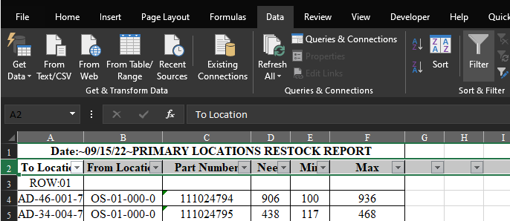

1 restock
Filtering Restock Report.
Go to Data
Activate the option filter in the second row
Shortcut:
select row two and press
Ctrl + Shift + L

Slide 19
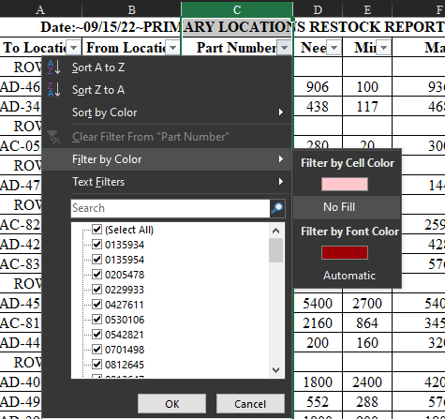
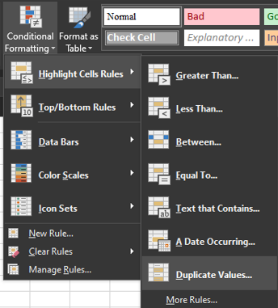
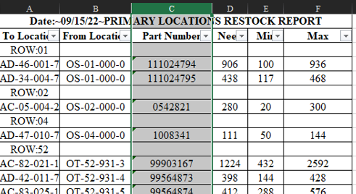
1 restock
Filtering Restock Report.
Apply conditional formatting
Select Highlight Cell Rules
Select Duplicate Values
Go to Home tab
Select Column C (Part Number)
Filter by color and select No Fill

Slide 20
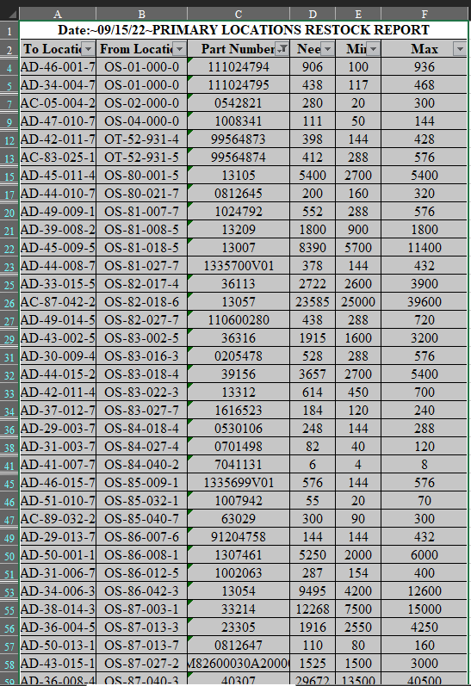
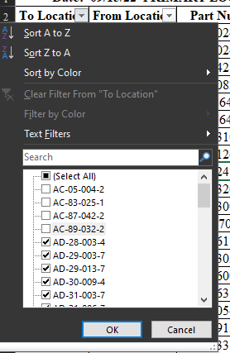
1 restock
Filtering Restock Report.
In the column to location deselect AC
Select all and print

Slide 21
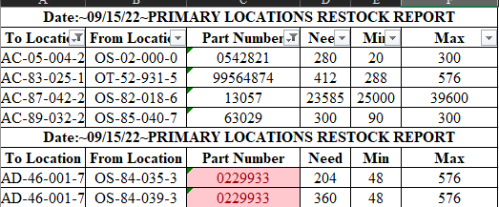
1 restock
Filtering Restock Report.
Put the duplicated values and AC in other tab

Slide 22
1 restock
Once you have your restock report
you are ready to get down the material

Slide 23
1 restock
Save restock in primary locs
Restocks AC locations

Slide 24
1 restock
Restock AC locations

Slide 25
2. carry up and store Overstock
The assigned area to put overstock pallets is forward the conveyor.
Identifies the pallets and ensures their conditions:
Well-planked
Labeled
Wrapped
Visible OT
If the OT is a mixed pallet it must have an OT content

Slide 26
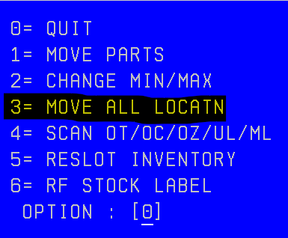
2. carry up and store Overstock
2.1 Moving All Location
1.- Main Menu.
Select option 2 (Matl Handlng).
2.-.Select option 1 (Move Parts).
3.- then
Select option 3 (MOVE ALL LOCATN)

Slide 27
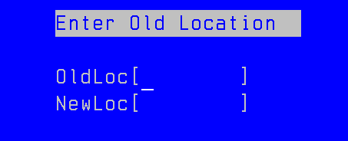
2. carry up and store Overstock
2.2. Move Parts: product movement screen
Scan or enter location you want to move.
Scan or enter the new location.
Example: Scan OT Look for an empty location Scan the new location

Slide 28
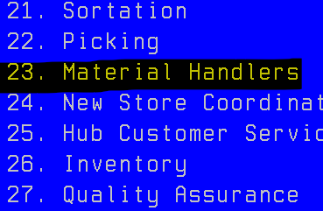
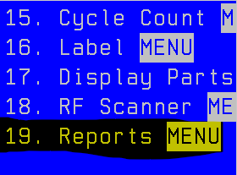
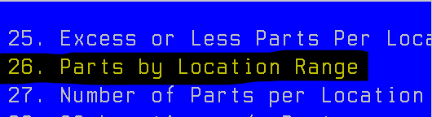
3. Consolidation
Process to consolidate product.
Run Parts By Location Range in Oper One
Pathway: 23 – 19 – 26
1.- Main Menu.
Select option 23 (Material Handlers).
2.-.Select option 19 (Reports).
3.- then
Select option 26 (Parts By location range)

Slide 29
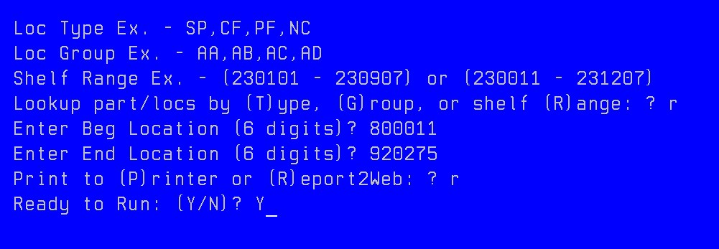
3. Consolidation
2. Parts By Locations screen
Select (R)ange
Enter begin loc 800011
Enter End loc 920275
Select (R)eport2Web
Y and enter

Slide 30
3. Empty locations
Process to make spaces.
Visual way.
The visual way to make spaces is:
Select a location in the OS locations which contains a small amount of material.
Scan the part number and press F7.
Takes the material to another location to consolidate it.

